Slide 1
EU update and response
The case against SyRI
Litigating Algorithms Workshop
AI Now Institute
June 21st 2019
Anton Ekker
Attorney at law
www.ekker.legal

Slide 2
- Anton Ekker, LLM, PhD
Attorney at law, Amsterdam, The Netherlands
Privacy & ICT Law

Slide 3
Talking Points
Update on the SyRI case
Conditions for using Algorithmic Decision Systems under the General Data Protection Regulation (GDPR):
Purpose limitation
Profiling / Automated Decision Making
Transparancy
Response to Session 3: Public Benefits and Collateral Consequence

Slide 4
Systeem Risico Indicatie (SyRI)
Risk profiling system aimed at prevention of social security, employment and tax fraud
SyRI Projects:
Administrative bodies initiate partnership for data exhange
Data analysis by Department of Social Affairs and Employment
Risk Notification Register
Further investigation within 2 years
Subpoena § 3.15 – 3.22

Slide 5
SyRI Project Rotterdam
2018: 25.000 citizens assessed in Bloemhof / Hillesluis
1.263 individuals / households flagged as ‘fraud risk’
Project currently on hold after objections by Rotterdam City Council

Slide 6
Notes:
Deeply offended

Slide 7
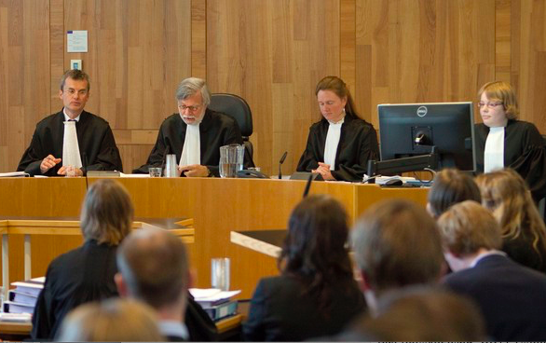
“Class action” against SyRI
Plaintiffs:
Coalition of Privacy Organisations:
Netherlands Lawyers Committee for Human Rights (NJCM) / Privacy First / Platform Protection Civil Rights / KDVP
Labor Union (FNV)
Two individuals
Project website: www.bijvoorbaatverdacht.nl
Sponsored by PILP
Purpose:
End the use of SyRI by the Dutch government
SyRI Law and Decree must be declared non-binding for violation of right to privacy
(Subpoena, p. 47 & 48)
29 October 2019: Hearing at Court of The Hague
Notes:
Suspected beforehand , no presuption of innocence. Suspect before the crime was committed.
Professor Philip Alston is the current Special Rapporteur on extreme poverty and human rights.
VN Special Rapporteur on Extreme Poverty and Human Rights, Philip Alston, erg geïnteresseerd is in de zaak.
Hij gaat een Amicus brief sturen aan de rechtbank om uit te leggen dat ze vinden dat deze zaak ook buiten Nederland van groot belang is voor het debat over de implicaties van het gebruik van digitale technologieën rond uitkeringssystemen en armoede.

Slide 8
Main legal objections
- Violation of constitutional right to privacy / GDPR
- Violation of due process / presumption of innocence (art. 6 ECHR)
- Bias / discrimination
- Lack of independant oversight

Slide 9
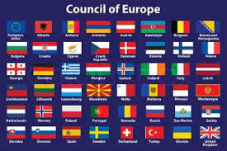
Violation art. 8 ECHR (Private life)
Requirements for limitation are not met:
use of SyRI is not foreseeable / lacks legal basis
necessity & proportionality have not been substantiated
Subpoena § 4.6 – 4.12 / 4.20 – 4.22 / 5.5 – 5.47

Slide 10
Purpose limitation
“When we share personal data with others, we usually have an expectation about the purposes for which the data will be used. There is a value in honouring these expectations and preserving trust and legal certainty, which is why purpose limitation is such an important safeguard, a cornerstone of data protection.”
Article 29 Data Processing Working Party: Opinion 03/2013 on purpose limitation, p. 4.
Art. 5 section 1 sub b GDPR.
Subpoena § 5.48.
Notes:
(3) The Purpose Specification Principle. The purposes for which personal data are collected should be specified not later than at the time of data collection and the subsequent use limited to the fulfillment of those purposes or such others as are not incompatible with those purposes and as are specified on each occasion of change of purpose. (4) The Use Limitation Principle. Personal data should not be disclosed, made available or otherwise used for purposes other than those specified, except a) with the consent of the data subject, or b) by the authority of law.

Slide 11
Purpose limitation
“[…] the general principles of data protection law […] become diluted, possibly to the extent of practical irrelevance, where the purpose itself is left without any meaningful definition or limitation.”
Catt v. The United Kingdom (Application no. 43514/15)
Concurring opinion Judge Koskelo, par. 6.

Slide 12
Purpose limitation
Purpose specification: art. 64 SyRI Act is too broad and too vague
Compatible use: purpose data processing SyRI is not compatible with original purposes
Article 29 Data Processing Working Party: Opinion 03/2013 on purpose limitation, p. 4.
Fair Information Practice Principles (FIPP) / OECD Guidelines on the Protection of Privacy (updated 2013)
Subpoena § 4.23 – 4.25 / § 5.6 - 5.17

Slide 13
Profiling
“any form of automated processing of personal data […] to evaluate certain personal aspects relating to a natural person, in particular to analyse or predict […] performance at work, economic situation, health, personal preferences, interests, reliability, behaviour, location or movements.”
Art. 4 sub 4 GDPR

Slide 14
Profiling: obligations data controller
Provide transparancy on data processing + logic + consequences;
Correct innaccuracies & prevent discriminatory effects.
Art. 6 GDPR, Recitals 63 & 71
Art. 29 Data Protection Working Party: Guidelines on Automated individual decision-making and Profiling
WP251rev.01
Notes:
Recital 63:
Every data subject should therefore have the right to know and obtain communication in particular with regard to the purposes for which the personal data are processed, where possible the period for which the personal data are processed, the recipients of the personal data, the logic involved in any automatic personal data processing and, at least when based on profiling, the consequences of such processing.
Recital 71:
The controller should use appropriate mathematical or statistical procedures for the profiling, implement technical and organisational measures appropriate to ensure, in particular, that factors which result in inaccuracies in personal data are corrected and the risk of errors is minimised, secure personal data in a manner that takes account of the potential risks involved for the interests and rights of the data subject and that prevents, inter alia, discriminatory effects on natural persons on the basis of racial or ethnic origin, political opinion, religion or beliefs, trade union membership, genetic or health status or sexual orientation, or that result in measures having such an effect.

Slide 15
Automated Individual Decision-making
The data subject shall have the right not to be subject to a decision based solely on automated processing, including profiling, which produces legal effects concerning him or her or similarly significantly affects him or her.
Exceptions: contract / consent / authorised by Union of Member State Law
Data subject has right to obtain human intervention, to express his or her point of view and to contest the decision.
Art. 22 GDPR
Subpoena § 5.63 – 5.64

Slide 16
Automated Individual Decision-making
Risk notifications produce legal effects / significantly affect citizens because they:
qualify as “increased security measures or surveillance”;
can have severe consequences, such as denial of social benefits and/or imposing of fines;
influence circumstances, behaviour or choices of individuals concerned.
Risk notifications are generated without human interference.
Art. 29 Data Protection Working Party: Guidelines on Automated individual decision-making and Profiling (
WP251rev.01), p. 10.

Slide 17
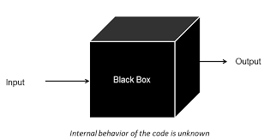
Lack of transparancy
SyRI is a black box: algorithms & risk models are not disclosed.
Dutch State violates transparancy obligations:
Article 13 & 14 GDPR: general obligation for data processsing:
Recital 63 GDPR: profiling & automated decision-making: logic + effects;
SyRI Projects: FOI Request to minister of Social Affairs and Employment was largely refused
Subpoena § 4.29 – 4.32 / 5.65 – 5.70
Background information FOI Request

Slide 18
Response to session 3
Automated Decision Systems technically very similar (MiDaS = SyRI);
Legal analysis differs:
US: due process / equal protection / discrimination
EU privacy / data protection (art. 8 ECHR / GDPR)
More individual claims in the US

Slide 19
Litigating Algorithms Europe
Exploring possible cooperation IViR & AI Now: workshops, publications, etc.

Slide 20
Questions?
Anton Ekker
www.linkedin.com/in/antonekker
anton@ekker.legal
0031 – 6 -43 77 53 35

